Slide 1

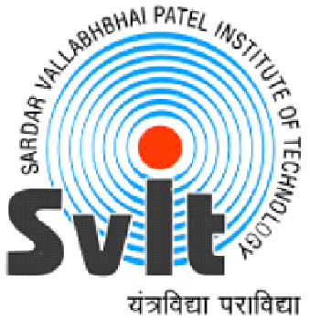
Forms of Organization
Mihir Mistry :- 160410116061
SY-IT-1

Slide 2
Type of organization
Line Organization
Line and Staff Organization
Functional Organization
Committee Organization
Matrix Organization
Hybrid Organization

Slide 3
1.Line Organization
A line organisation has only direct, vertical relationships between different levels in the firm. There are only line departments-departments directly involved in accomplishing the primary goal of the organisation. For example, in a typical firm, line departments include production and marketing. In a line organisation authority follows the chain of command.

Slide 4
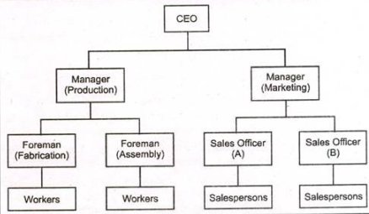
Features:
Has only direct vertical relationships between different levels in the firm.

Slide 5
Advantages
1.Simplicity:- As relations between subordinates and superiors are in straight line form, functioning is simple.
2. Clarity:- Each one in the organization is clear about their authority and responsibility.
3.Unity of command:- As superior-subordinates relations are clearly defined, unity of command can be maintained.
4.Faster Decisions:- As the main control is in the hand of top management, decisions can be taken and implemented faster.
5.Scope of promotion:- As all positions in the organization are fixd and linked with linear chain. Employees have good scope for promotion based on their performance.

Slide 6
Disadvantages
1.Traditional working:- Once established its operate in traditional way without any innovations.
2.Over dependence:- Success of the business depends upon few departmental heads.
3.Duplication of work:- Many times of work and lack of specialization, wastage of materials and man-hour occurs.
4.Lack of creativity and research:- As all department manages are busy handling their own department don’t get enough time to research and create something useful for the organization.

Slide 7
Application
Small scale industries
Military
Bureaucratic Government Departments
Enterprise where less activities are to be performed

Slide 8
2.Line and Staff Organization
Most large organisations belong to this type of organisational structure. These organisations have direct, vertical relationships between different levels and also specialists responsible for advising and assisting line managers. Such organisations have both line and staff departments. Staff departments provide line people with advice and assistance in specialized areas (for example, quality control advising production department).

Slide 9
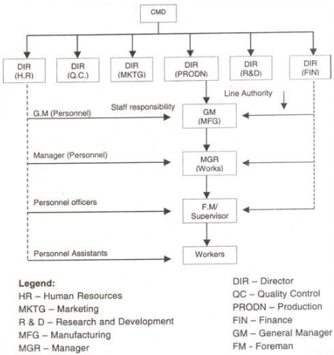

Slide 10
Advantages
Specialization:- Benefits of specialisation can be drawn from staff employees.
Effective planning analysis control and development activities.
Unity of command can be maintained.
Proper balance of authority and responsibilities.
Better coordination in large organisations having submit.

Slide 11
Disadvantages
1. Conflict between line and staff may still arise.
2. Staff officers may resent their lack of authority.
3. Co-ordination between line and staff may become difficult.
Application
Bigger organizations ( Big Steel Plants , Heavy Machine Building Industries etc)
Government Organization ( Big public sector units )

Slide 12
3.Functional Organization
Functional organization is a type of organizational structure that uses the principle of specialization based on function or role.
It allows decisions to be decentralized since issues are delegated to specialized persons or units, leaving them the responsibility of implementing, evaluating, or controlling the given procedures or goals.

Slide 13
Advantages
Specialization:- Services of specialists in respective fields can be availed.
Separation of work:- Since mental and planning work has been separated from routine work, over-load of work can be avoided.
Independence:-Due to decentralization, independence of employee can be maintained lending to improve creativity and innovations.

Slide 14
Disadvantages
1.Complexity:- The structure within complex, as can be seen from the figure.
2.Lack of Clarity:- Channel of communication is not as clear as in line organisation.
3. Lack of Discipline:- Due to lack of unity of command, one subordinate is responsible to many managers making him indiscipline usually.

Slide 15
Application
Large industrial unit.
Where many activities are to be performed.
Variety of skills and function requirement in job.

Slide 16
4. Committee Organization
Committee is not a separate organization as such. It is just an extended idea of line and staff system. Under this system, instead of a single officer acting in advisory capacity, there is a committee of experts for advice and guidance in business planning and execution. These committees play a wider role in the management of plant organization and are found at all levels of management hierarchy. But in medium sized undertakings, they are found only at top level.

Slide 17
Advantages
Better coordination between different department whose staff member are in the committee.
specialist member can devote more time and service in specific problem.
Information transactions becomes easy and faster.
Democracy in decision-making can be maintained.
Centralization of authority can be avoided.

Slide 18
Disadvantages
Sometime due to larger number of committee members, decisions are delayed.
In case of failure, no one can be held responsible.
confidentiality of decision cannot be maintained.
Many committee members are inactive and don’t contribute anything.
Application
In large organization having many complex problem and issues which are difficult to handle by an individual.

Slide 19
5.Matrix Organization
A matrix organizational structure is a company structure in which the reporting relationships are set up as a grid, or matrix, rather than in the traditional hierarchy. In other words, employees have dual reporting relationships - generally to both a functional manager and a product manager.

Slide 20
Advantages
It is a tailor-made structure to handle a particular assignment.
It is a flat or a layer less structure, so behavioral issues of level differences do not aryse.
It avails the benefits of specialization in an integrated and co-ordinated manner.
It avails the flexibility in task performance.
Disadvantages
The project term has a short-term existence and thus it is not available for long term strategies.

Slide 21
6.Hybrid Organization
A hybrid organization is an organization that mixes elements, value systems and action logics (e.g. social impact and profit generation) of various sectors of society, i.e. the public sector, the private sector and the voluntary sector.
Advantages
The synergy advantage of two expert companies with core competence avails best products at affordable price.
It facilitates the economies of the scale along with the benefits of new product development.
It results into a win-win strategy for both the co-ordnating organizations.

Slide 22
Limitations
The reservation of any form on either part of the co-ordinating organizations prevents the best user of synergy advantages e.g. restrictions on the use of research output.
Sometimes the egoistic approach on the part of the one or both of the organization progress as a hindrance in availing the best benefits of the combination.

